Slide 1

2023 Annual Meeting
Ashland High School
May 13, 2023

Slide 2
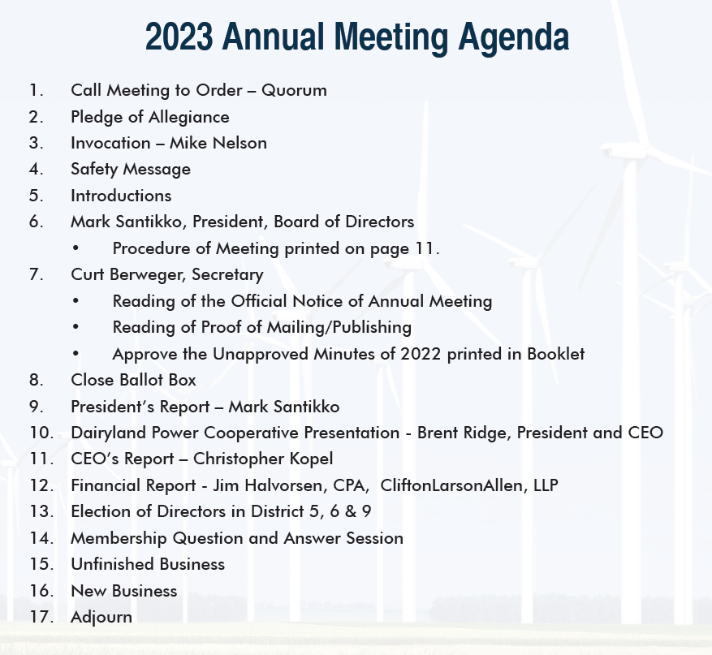

Slide 3
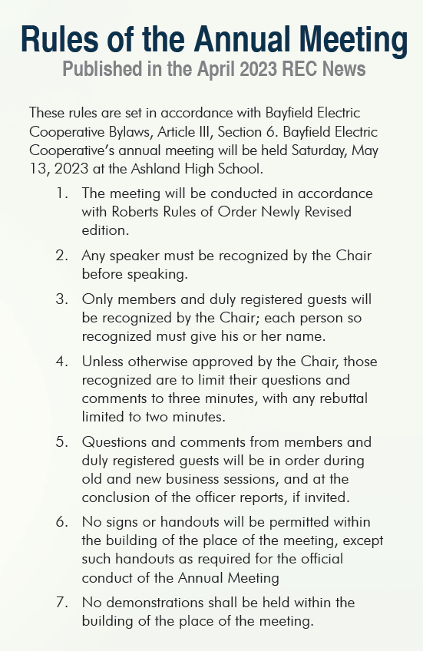

Slide 4
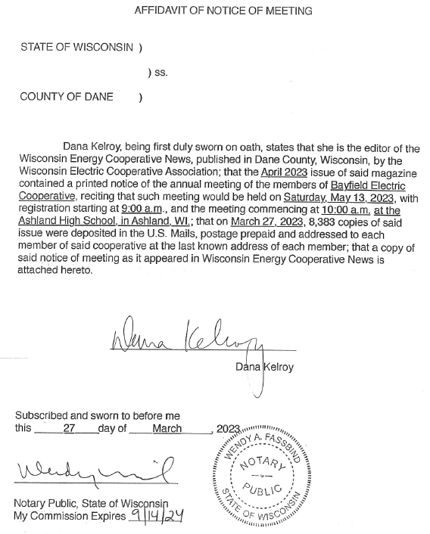

Official Notice and Proof of Mailing/Publishing

Slide 6
Dairyland Power Cooperative Update
Brent Ridge, President & CEO
Presented To: Bayfield Electric Cooperative
Annual Meeting
May 13, 2023

Slide 7

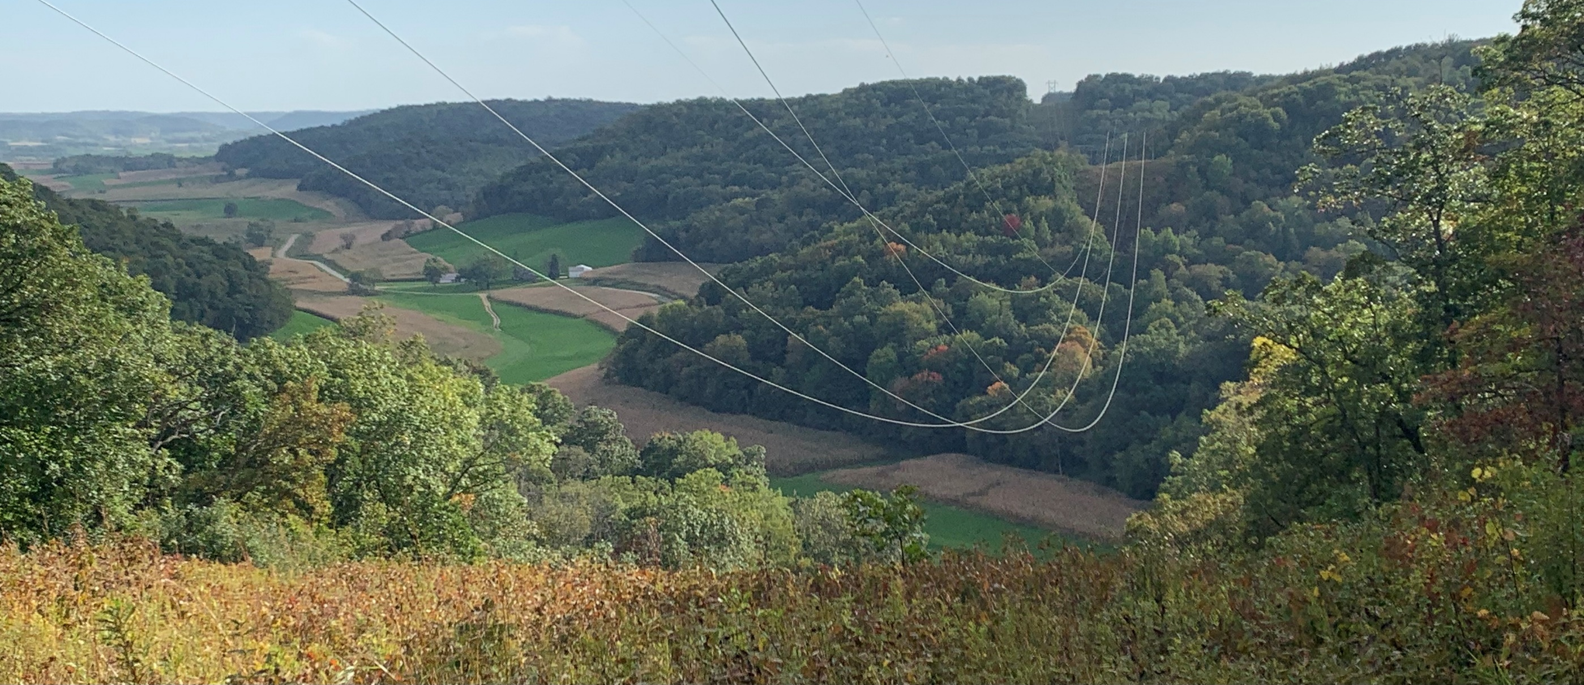
THANKS & GRATITUDE
MEMBERS
TEAMMATES
DAIRYLAND MANAGERS
ASSOCIATION
DAIRYLAND BOARD

Slide 8
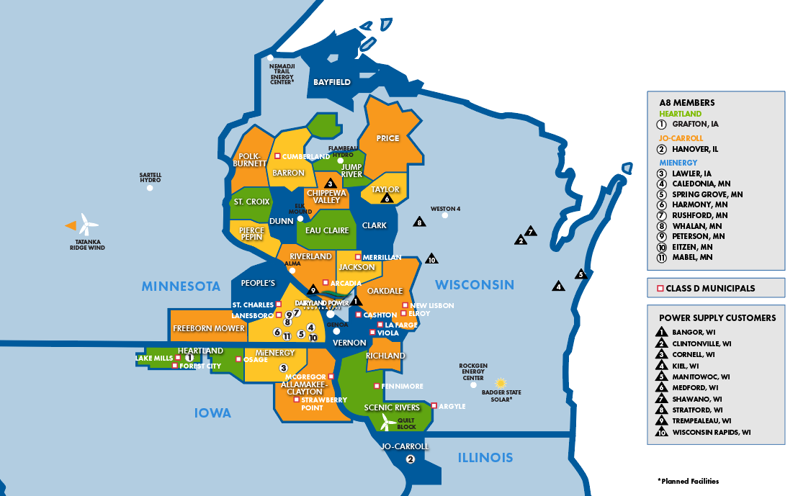


8
Dairyland System Only

Slide 9





How Do We Achieve Sustainability?
Safe, reliable & predictable delivery of electricity
Cost competitive: lower costs, increase load and grow outside revenue
Sustainability = Creating long-term value by seizing opportunities and managing risks related to environmental and social impacts
Methodically lower our carbon output without sacrificing safety & reliability
We are in the people business
Notes:
Brent

Slide 10
Prioritizing Reliability
Keep the lights on
Who owns reliability and affordability?
  Electric utilities and cooperatives
  Policy makers and Congress
  Federal Energy Regulatory Commission (FERC)
  Environmental Protection Agency (EPA)
In December 2022, there were 9 states across the U.S. that experienced
rolling blackouts
Importance of the integrity of the grid during extreme weather and as
beneficial electrification penetrates the grid
Notes:
https://www.youtube.com/watch?v=svabf5spWK0
Transcript:
job one is keeping the lights on
it's that simple
and yet while it's that simple I fear
that in the policy world people aren't
recognizing that
and we've got examples where we're
moving in that direction of less
reliable Supply in this country it just
happened
December 23 December 24th we're in nine
states there were rolling blackouts is
this what America is supposed to be
where if we ever have a significant cold
or warm weather Spike that our grid gets
pushed right to the edge and has
problems
this is something that my membership is
concerned about we're trying to be a
voice of reason we're at a point now in
the electric side where we've got to be
very thoughtful about the Integrity of
the grid and the reliability of the
grading when it comes to the operating
side of the electric grid utilities own
that reliability issue right
who owns the reliable issue on the
policy side
my answer is I don't think anyone owns
that issue and that's part of our
problem so who's in charge is it ferc is
it doe is it the Congress
I don't think anyone is fully embracing
the idea of how we maintain this grid
which is so Central to how this country
functions every day and oh by the way
we're also in the process of
electrifying so many other aspects of
our economy that the grid is going to be
all the more important but all the more
stressed I mean does any does anyone at
the EPA think about reliability when
they're talking about making new rules
and regulations we all know the answer
to that we pride ourselves in the co-op
world for being the truth tellers we
really we're really all about just
keeping the lights on it really does
matter to us and so while you hear it
from all of us in the energy sector and
you may gloss over those words don't
gloss over them reliability
affordability that really is job one for
us it's it's our mission every day it's
what we're going to continue to pursue

Slide 11

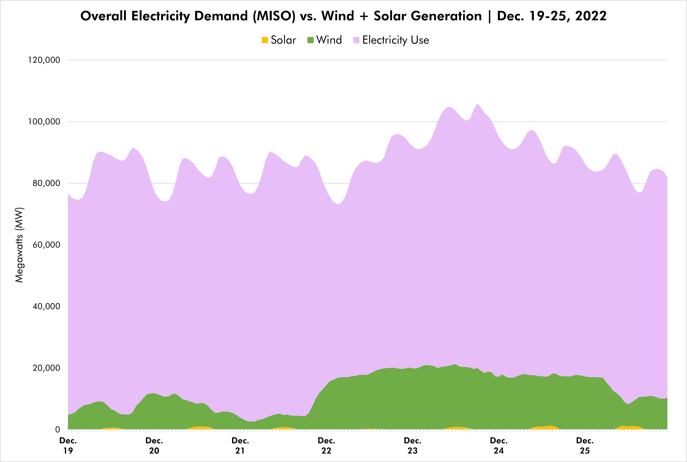
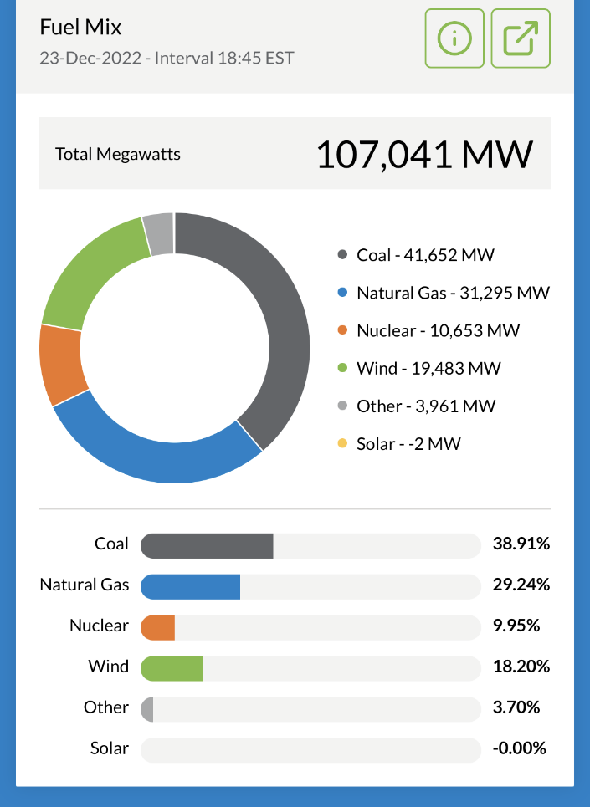
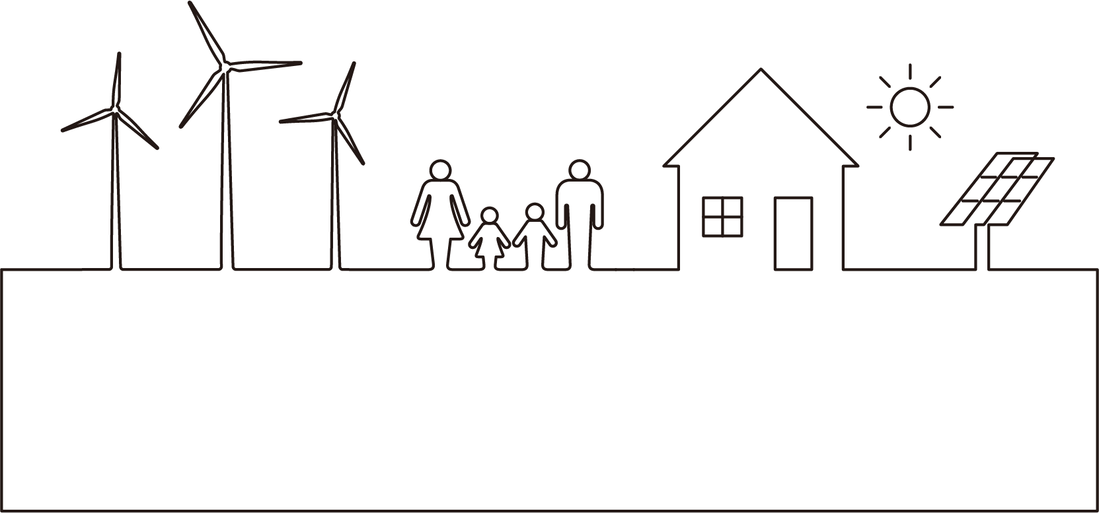
Overall Electricity Demand (MISO*) vs. Wind & Solar Generation | Dec. 19-25, 2022
WINTER
At 5:45 p.m. (CST) on
Dec. 23, 2022, electricity needs in MISO were met with a diverse fuel mix:
From Dec. 19-25, 2022, (on average) wind and solar generation met 14% of the electricity needs in the MISO footprint
*Midcontinent Independent System Operator

Slide 12

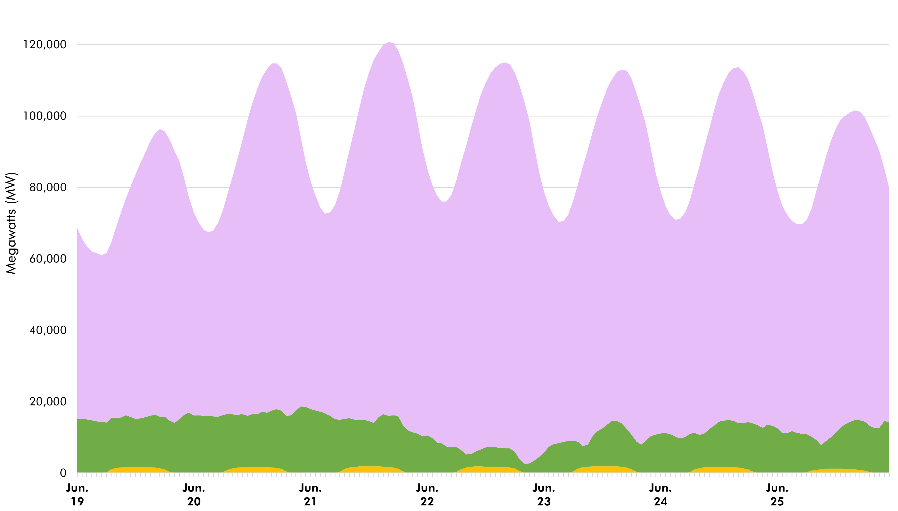



Overall Electricity Demand (MISO) vs. Wind & Solar Generation | June 19-25, 2022
SUMMER
The gap between available renewable energy generation and electricity demand is filled by coal, natural gas & nuclear.

Slide 13
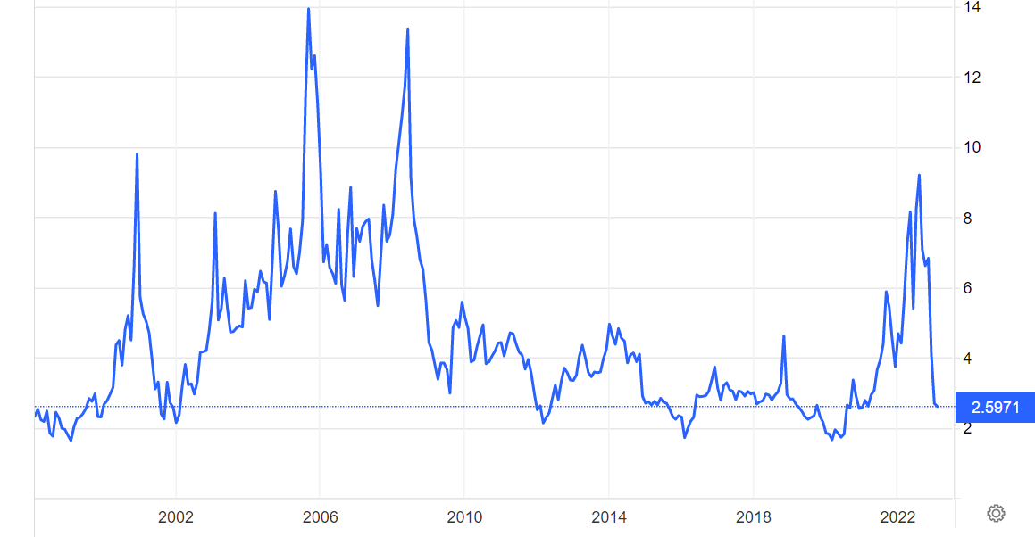
Natural Gas Prices 1998-present (25 years)

Slide 14

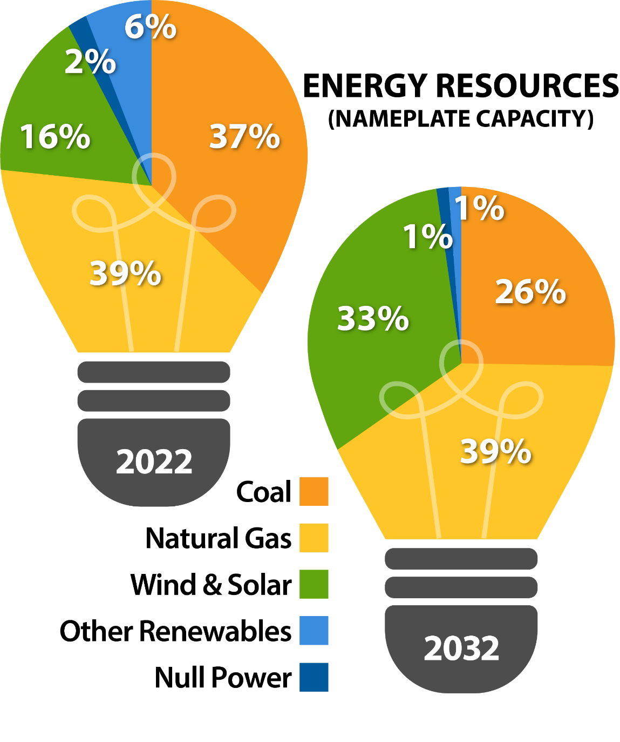

Dairyland’s Current Energy Mix
GROWING
DECLINING
GROWING
GROWING
STABLE
Diversification through load growth, natural gas and renewable additions

Slide 15
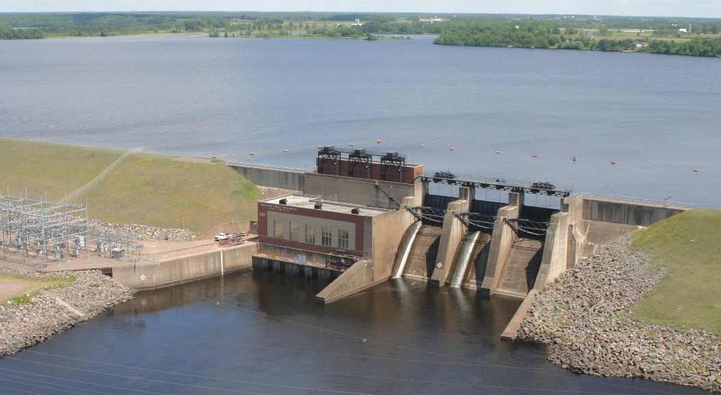

Renewable Generation Resources
(Owned and Contracted)
Flambeau Hydroelectric Station
18.8 MW
Ladysmith, WI
Sartell Hydro Station
10 MW
Sartell, MN

Slide 16



Renewable Generation Resources (Contracted)
Quilt Block | 98 MW
Tatanka Ridge | 51.6 MW
Winnebago | 20 MW
Adams | 17.4 MW
Other wind* | 20.4 MW
Small Solar (40 sites) | 44.2 MW
Badger State Solar* | 149 MW
Timberline Trail | 5.6 MW
Central Disposal | 4.8 MW
*Coming soon in 2025
*Across multiple facilities

Slide 17
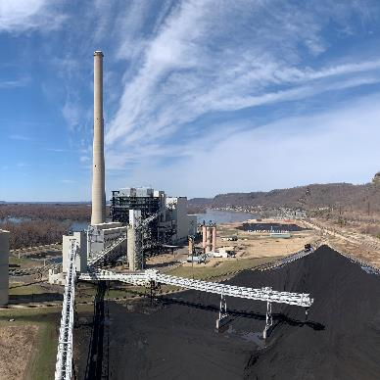
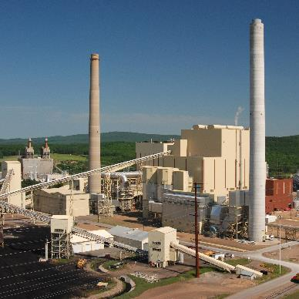
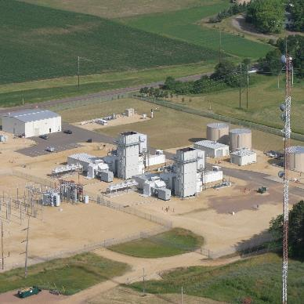
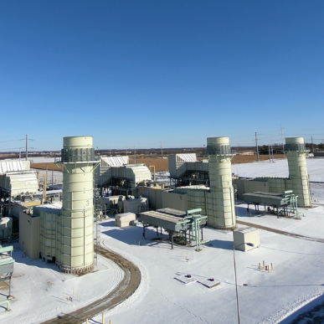
Generation Resources
387
165
74
503
MW
MW*
MW
MW
Elk Mound
Combustion Turbines
RockGen
Energy Center
John P. Madgett
Station
Weston #4
*Dairyland’s share
(30% ownership)
Coal
1979
Alma, WI
Coal
2008
Wausau, WI
Natural gas/oil
2001
Chippewa Co., WI
Natural gas/oil
2021(Acquired)
Cambridge, WI

Slide 18
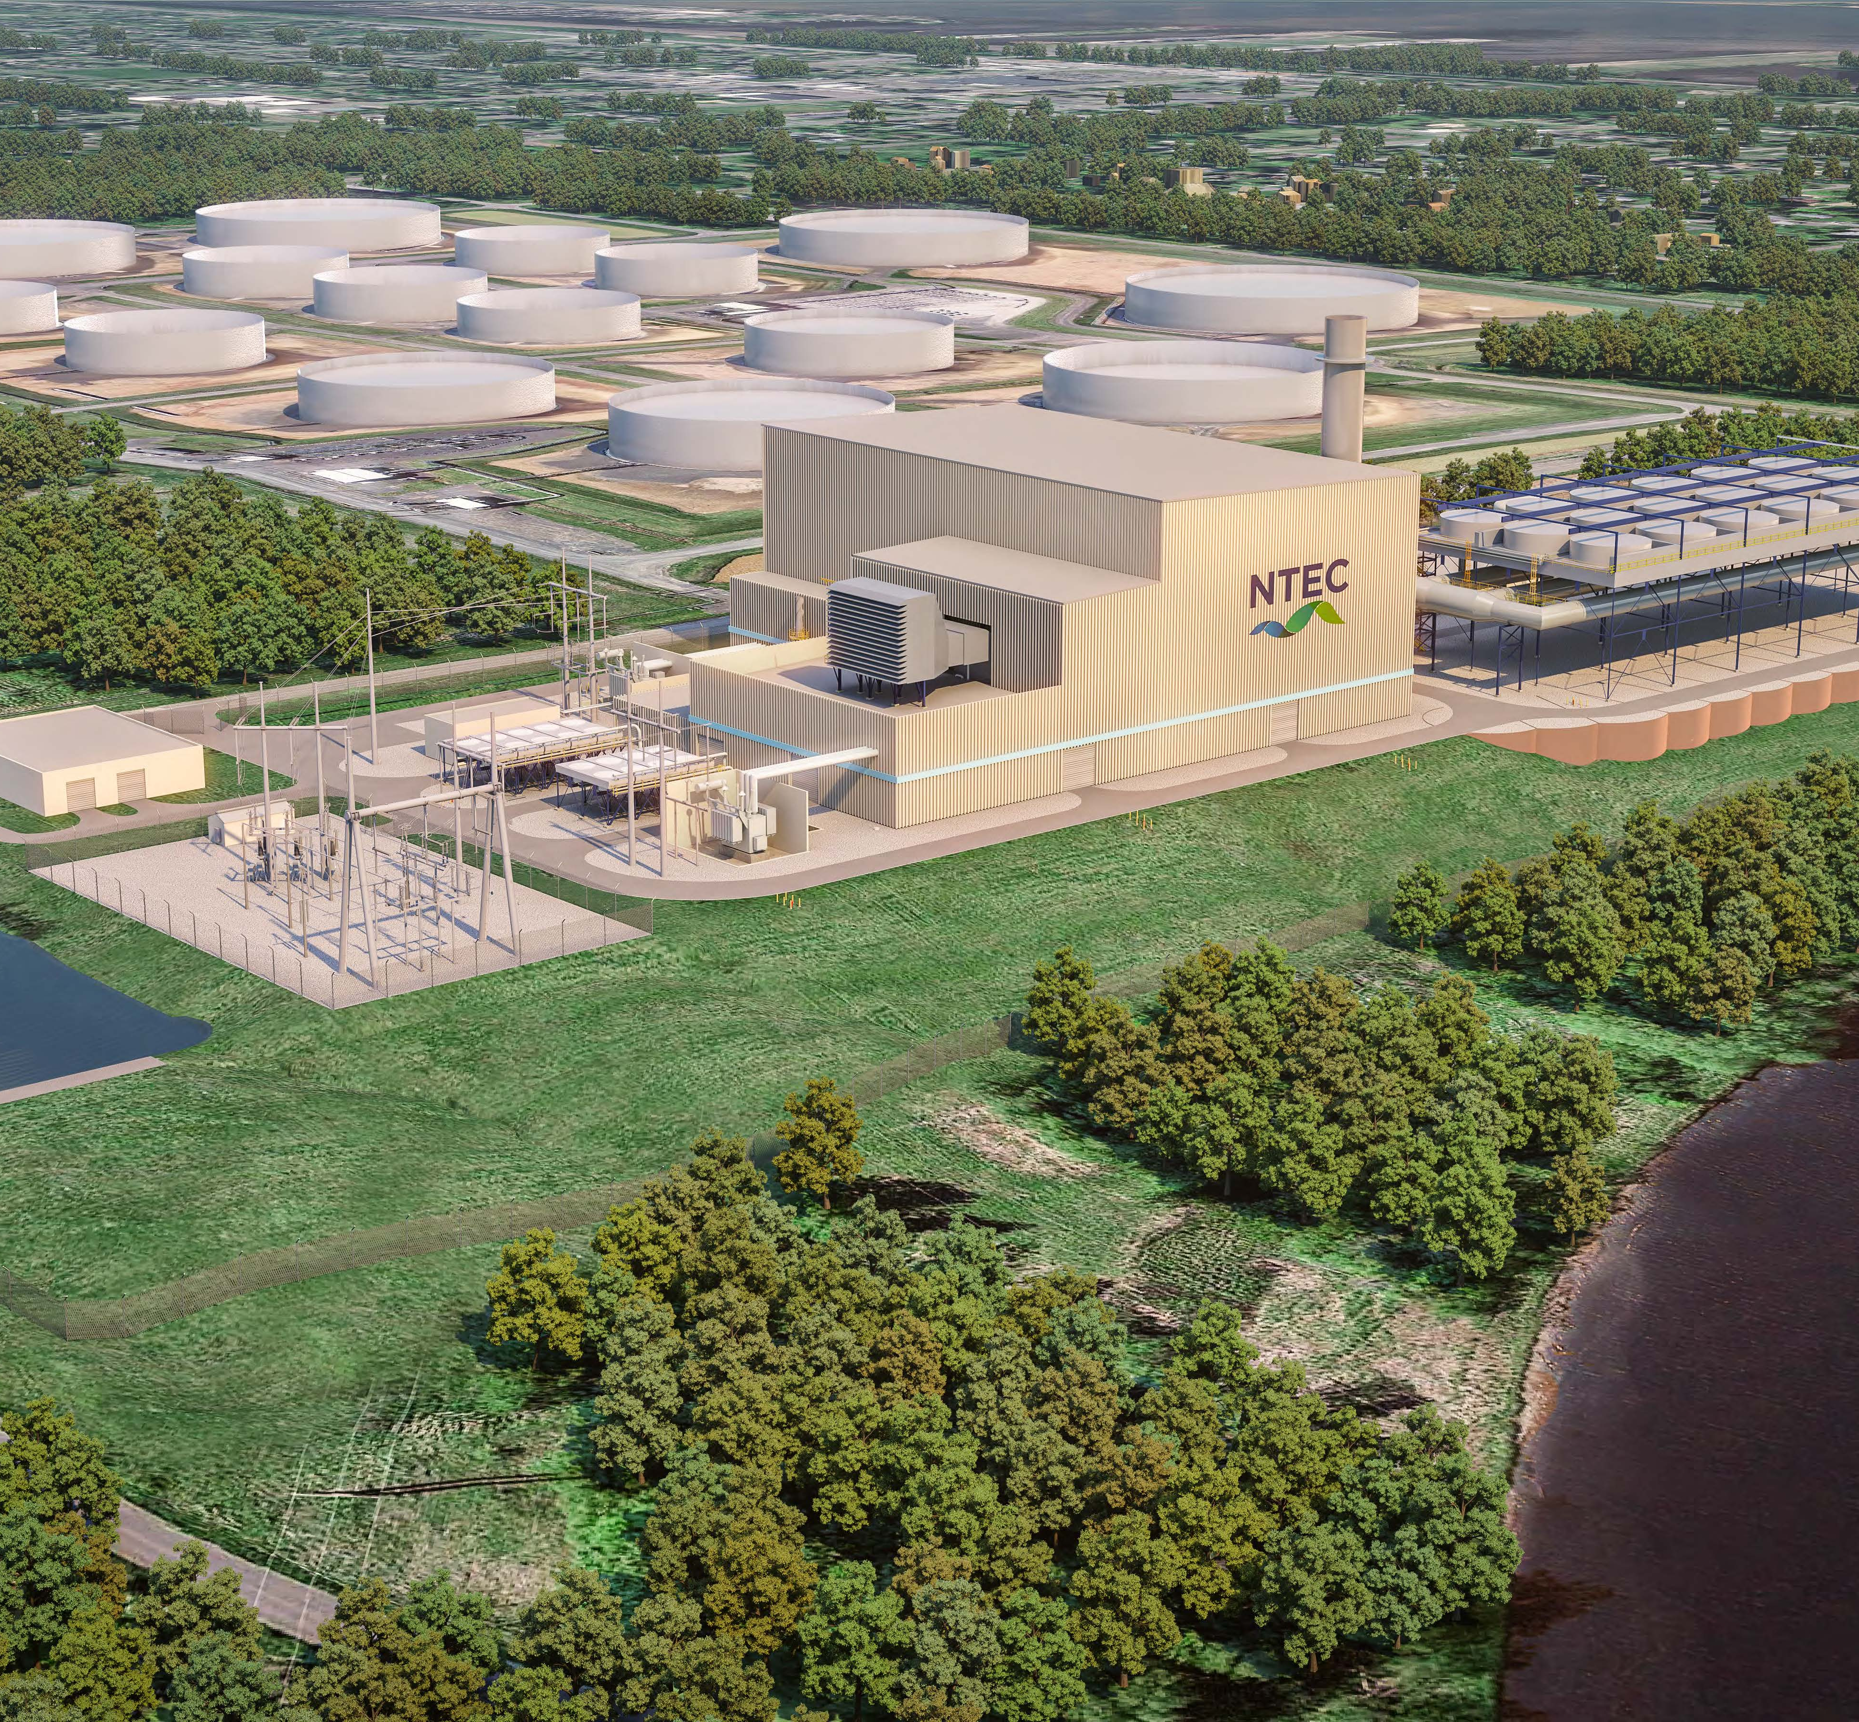
Nemadji Trail Energy Center (NTEC)
Power Plant Development
Reformation of project in 2021
  Dairyland 50%
  Basin Electric 30%
  Allette/MN Power 20%
Minnesota Power still the operator
Legal challenges remain
Finalizing regulatory permitting

Slide 19

Nuclear Small Modular Reactors (SMRs)
Nuclear technology is evolving…
NuScale
Pressurized water reactor
First site planned in Idaho
X-Energy
Pebble Bed
TerraPower
Molten Salt (Wyoming)
GE-Hitachi
Memorandum of Understanding entered
Delay due to geopolitical issues
Boiling Water Reactor BWRX-300 (Canada and TVA)
Does not emit CO2
Provides 24/7 energy
production
Exploring technology
options
Site selection
Public education
Cost and when nuclear
makes sense
Timing – patience while technology and pricing develops
CONSIDERATIONS

Slide 20
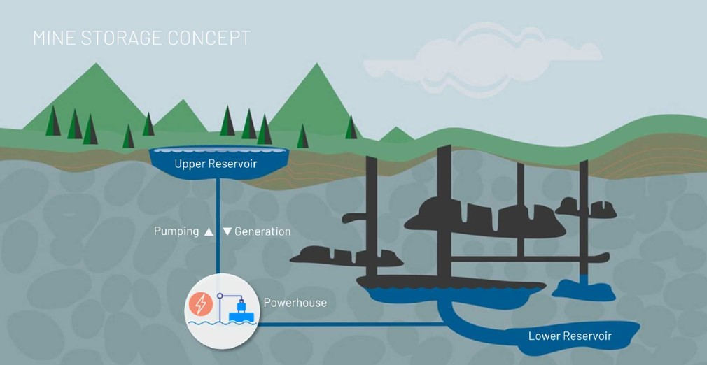


Mine Storage International AB &
Michigan Technological University (MTU)
Exploring the potential for pumped storage hydropower in the Upper Midwest (energy storage system)
Supports grid reliability and renewable energy generation while repurposing retired industrial sites in an innovative way
  Mine Storage (Stockholm, Sweden)
  MTU (Houghton, Michigan)

Slide 21




Safe, Reliable and Cost-Effective Energy for the Future
We will take a balanced and measured
approach to carbon reduction
Investment is trending toward
renewable energy
We must ensure a reliable and
affordable flow of electricity
  Innovation will drive the transition.
  Traditional resources will keep the light on
“All of the above” approach
  Retiring coal plants within MISO
  Natural gas = lower CO2 emissions + renewable-enabling
  (can ramp up/down quickly)
  Add renewable
  Consider advanced nuclear
Balance =
safe, resilient, environmentally responsible

Slide 22



Slide 24
CEO Report
2023 Annual Meeting
Christopher Kopel
May 13, 2022

Slide 25
CEO Report Agenda
Review Distributed Energy Resources Policy 300.11 Changes
Results for Member Engagement Survey
BEC Strategic Plan

Slide 26
Summary of Policy 300.11 History
 | Credit for Energy Flowing to Grid | Rate for Annual Excess Energy | Timing of Annual “True-up”
Original Policy (before Mar 2020) | 100% Credit (1 kWh to grid = 1 kWh Credit) | No Credits | Set by member at enrollment
Revised Policy (Mar 2020) | BEC Monthly Wholesale Energy Cost | No Credits | Not Applicable (Monthly True-up)
Current Policy (until 4/1/2025) | 100% Credit (1 kWh to grid = 1 kWh Credit) | BEC Annual Wholesale Energy Cost | April 1 to March 31
Current Policy (NEMA effective 4/1/2025) | Defined by NEMA (1 kWh to grid = 0.9 kWh Credit) | BEC Annual Wholesale Energy Cost | April 1 to March 31

Slide 27
Summary of Policy 300.11 Changes
All solar “Grandfathered” until Mar 31, 2025
  Full energy credit (1 kWh to grid = 1 kWh Credit), up to annual consumption
  Excess beyond annual consumption - BEC’s annual wholesale energy cost (currently approximately $.035/kWh)
  Systems installed after March 9, 2020, will also be “Grandfathered” retroactively
Net Energy Metering Agreement (NEMA) beginning April 1, 2025
  20-year contract between BEC and individual member
  Energy credit defined by NEMA (Initially 90%, 1 kWh to grid = 0.9 kWh Credit)
  Excess beyond annual consumption - BEC’s annual wholesale energy cost (currently approximately $.035/kWh)
NEMA terms set by the Board and subject to periodic review
  Energy credit in NEMA can change for future contracts
  Does not change existing NEMA contracts
Revised Policy 300.11 approved October 13, 2022

Slide 28
2022 Satisfaction Survey
Bayfield Electric Cooperative

Slide 29
Overall Satisfaction

Slide 30
Performance Attributes
1-5 Scale: 1 = Very Poor; 5 = Excellent
Notes:
Members were asked to evaluate 18 performance quality attributes related to member service, electric service, communication, billing, and cost. On 11 of the attributes measured, the mean ratings are above 4.00, a “good” rating on a 5-point scale including one evaluated above 4.50, the excellent threshold. You’ll notice that the top two attributes are both related to your employees.
The attributes on which BEC is rated least well are the monthly service charge and charging reasonable rates. While this is an area that is often rated lower in cooperative satisfaction research, with mean ratings of 2.99 and 3.21, respectively, this may be a concern for the co-op.

Slide 31
Member Identity
-12

Slide 32
Consumer Segments

Slide 33

Environmental Champions (47%)
Second highest satisfaction with co-op
Highest level of member identity
Most likely to have solar at home and most likely to install them in next 3-5 years
Highest level of support for solar policy
General agreement for I feel I do more than most to conserve electricity but is not highest
Demographically:
Tend to be older | Most likely to live alone
Highest level of education | Least likely to have children in home
Highest home value

Slide 34

Cost-Conscious Supporters (12%)
Highest satisfaction with co-op
Least likely to have solar at home
Highest agreement for I feel I do more than most to conserve electricity
Demographically:
Least likely to own home | Most likely to be married
Lowest household income | Most likely to be female
Largest family size

Slide 35

Complacent Consumers (22%)
Least likely to have contacted co-op in past year
Demographically:
Tend to be younger
Lowest home values
Least amount of formal education

Slide 36
Key Findings
Overall satisfaction is good.
Performance attributes are generally good.
Member identity is low.
Almost half fall into the Environmental Champion segment.
Next largest group is Complacent Consumers.
Few currently have solar at home.
Most do not support the co-op’s subsidy of those with solar at home.

Slide 37

Strategic Goals and Objectives

Slide 38
Strategic Goals
Financial
Ensure the Financial Security of the Cooperative
Member
Engagement
Enhance Member Communication and Relationships
Operations Reliability
Enhance Operational Excellence and Reliability
Power
Supply
Develop appropriate Power Supply Options to correlate with membership needs
Safety
Continuously improve Culture of Safety

Slide 39
Financial
Goal – Ensure the Financial Security of the Cooperative
Objectives
Conduct cost of service study
Design and implement rates to include an electric vehicle rate
Develop comprehensive long-term financial plan and policy
  Infrastructure
  Equity Management
Conduct board financial training

Slide 40
Member Engagement
Goal – Enhance Member Communication and Relationships
Objectives
Develop comprehensive communication plan and strategy
Analyze electric vehicle program options

Slide 41
Operations Reliability
Goal – Enhance Operational Excellence and Reliability
Objectives
Develop long term capital investment plan
Consider line loss evaluation
System improvement
Analyze tie line opportunities
Conduct cyber security analysis and evaluate training options

Slide 42
Power Supply
Goal – Develop appropriate Power Supply Options to
correlate with membership needs
Objectives
Analyze renewable options
Coordinate with Dairyland to develop options
Analyze other power supply options

Slide 44
Bayfield Electric Cooperative Annual Meeting
Jim Halvorsen, CPA

Slide 45
Bayfield Electric Cooperative
Unqualified Opinion
Audit Report Presentation to BOD 4/13/23
Conduct audit in accordance with auditing standards generally accepted in the United States of America and the standards applicable to financial audits contained in Government Auditing Standards issued by the Comptroller General of the United States.

Slide 46
Bayfield Electric Cooperative

Slide 47
Bayfield Electric Cooperative

Slide 48
Bayfield Electric Cooperative

Slide 49
Bayfield Electric Cooperative

Slide 50
Bayfield Electric Cooperative

Slide 51
Thank you!

Slide 53
Members Question and Answer Session

Slide 55
Thank You!

